Slide 1
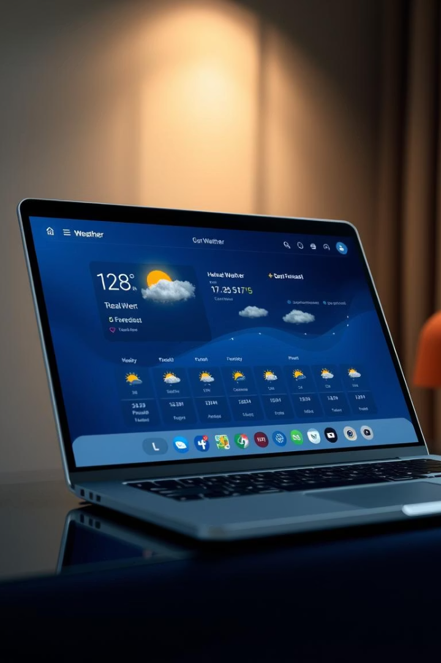
Weather Now: A Modern Weather Application
This presentation details "Weather Now," a MICRO IT PROJECT developed by [Your Name]. It's a modern, web-based application providing real-time weather updates.
by S.Darvesh mohiddin

Slide 2

Introduction to Weather Now
Sleek, Modern Design
Weather Now is a web app for real-time updates and a 5-day forecast.
Explored Core Technologies
I applied front-end tech, API integration, and responsive design.
Focused on User Experience
This project emphasized creating an intuitive and smooth user experience.

Slide 3





Objective of the Project
Interactive Web App
Build with HTML, CSS, and JavaScript.
API Data Integration
Fetch and display data using OpenWeatherMap API.
Location-Based Search
Implement real-time geographic weather searches.
Modular & Responsive
Practice clean coding and responsive UI design.

Slide 4
Tools and Technologies Used
Front-End Foundation
Data & Location
Design Principle
HTML5 / CSS3 for structure and style.
OpenWeatherMap API for real-time data.
Responsive Web Design for all devices.
JavaScript (ES6+) for logic and interactivity.
Browser Geolocation API for user location.

Slide 5
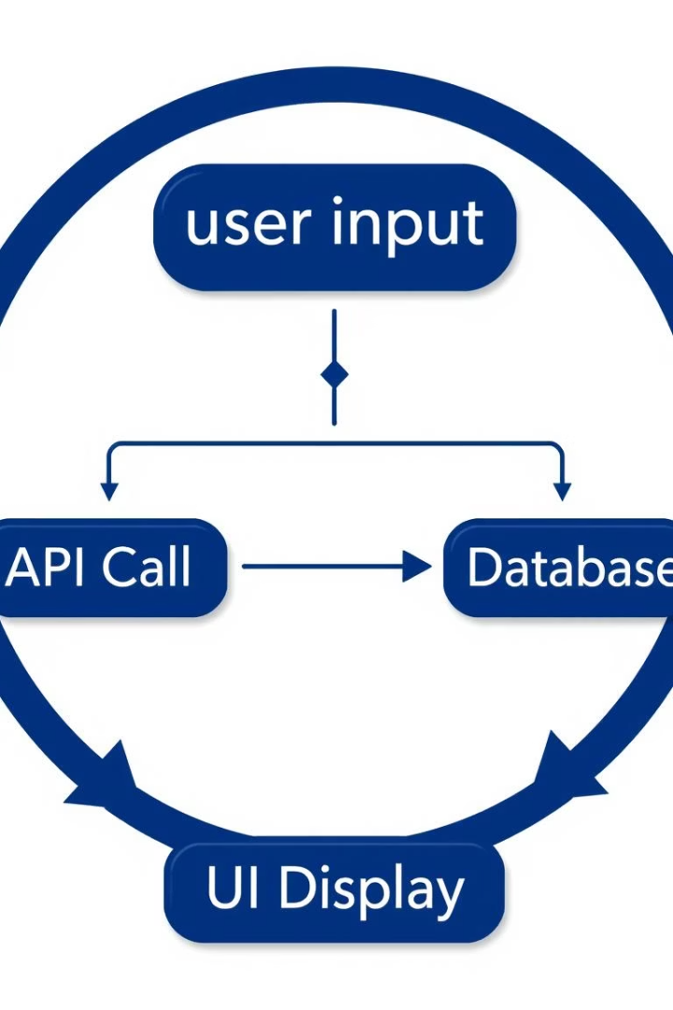
System Design and Architecture
The system design focuses on a clear data flow. Users input a city or use geolocation to fetch and display weather data and forecasts.
Data Flow
User input → API call → Display.
Main Features
Search by city or location.
Live temperature, humidity, wind, pressure.
5-day weather forecast.
Robust loading and error handling.

Slide 6
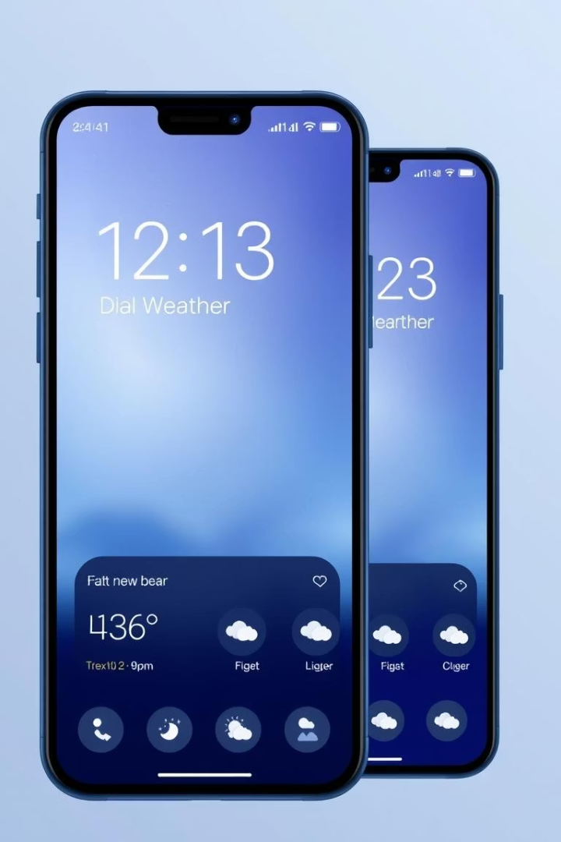




User Interface Design
Aesthetic Design
Responsive Layout
Visual Cues
Weather icon emojis based on conditions.
Clean gradient with glassmorphism.
Optimized for mobile and desktop.
Interactive Elements
Loading indicators and hover animations.

Slide 7
Key JavaScript Functions
searchWeather()
Fetches weather for given city.
getCurrentLocation()
Uses GPS for local weather.
displayWeather()
Updates UI with current data.
displayForecast()
Shows 5-day weather forecast.
generateFallbackForecast()
Mock forecast if API fails.

Slide 8

Challenges Faced
1
API Error Handling
Managing edge cases like "city not found."
2
Responsive Design
Adapting layouts for various screen sizes.
3
Loading States
Ensuring smooth transition animations.
4
Accessibility & UX
Maintaining consistency and user-friendliness.

Slide 9




Learning Outcomes
Front-End Experience
1
2
API Integration
Hands-on web development practice.
Mastered JavaScript fetch for data.
Debugging
UI/UX Design
Handled asynchronous operations.
4
3
Improved responsive and animated skills.

Slide 10

Conclusion: Future-Ready Skills
WeatherNow significantly sharpened my web development skills. It was particularly impactful for real-time data handling and UI/UX design. This project provided a valuable opportunity to implement a full-stack integration with genuine utility.
I am confident these skills will be invaluable for future projects.

